Slide 1
Review 2
-2010030151 K S Satyavarsan
2010030071 Jyothin Movva
2010030040 Devaraj Acharya
2010030341 Snehith Kamepally
2010030329 Karthik

Slide 2
Implementation flowchrat

Slide 3
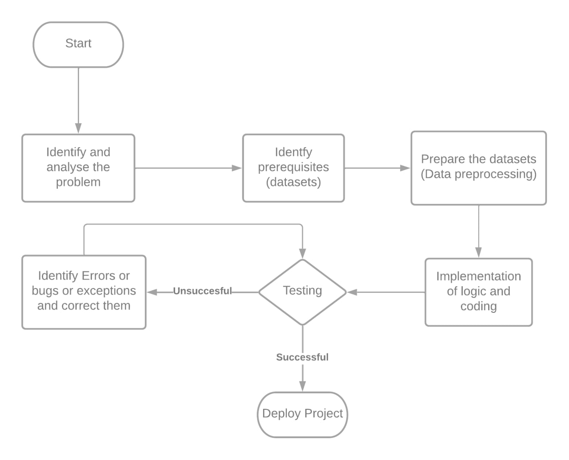

Slide 4
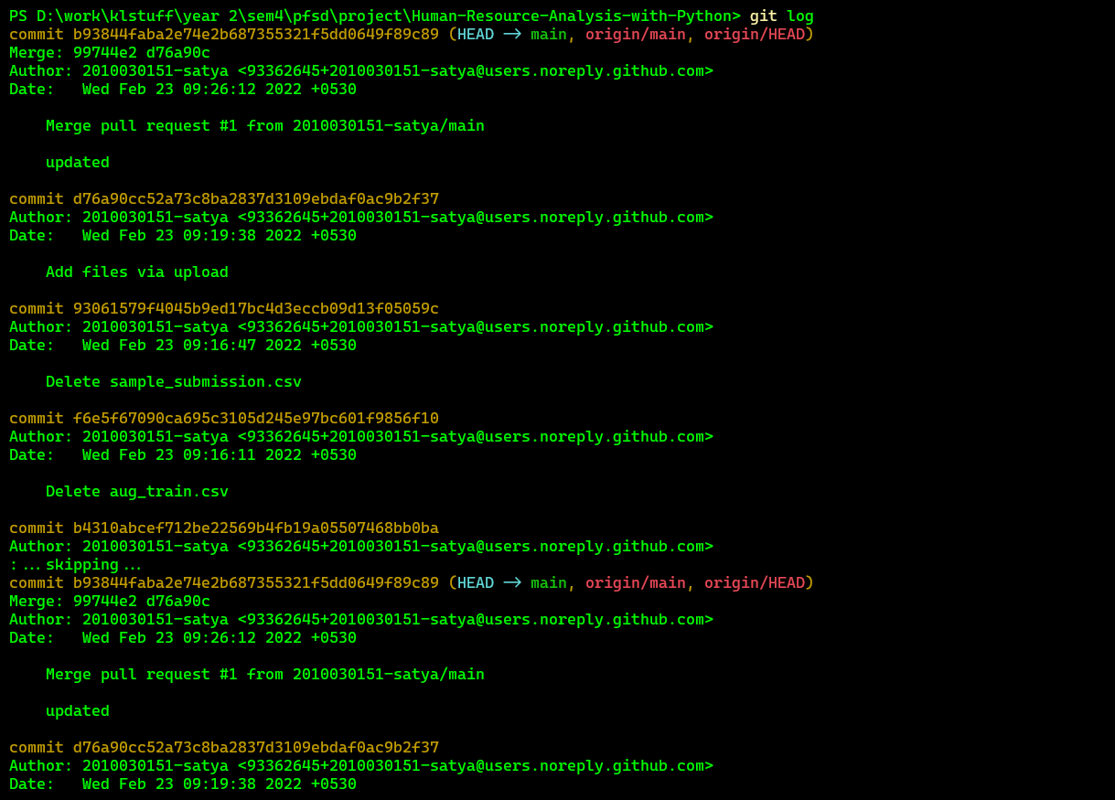
GITHUB COMMITS

Slide 5
Work progress
Data collected
Project will be implemented using seaborn, matplot.lib, ploty and flask
Flask environment for the project is functional
Generating plots from the given data is functional

Slide 6
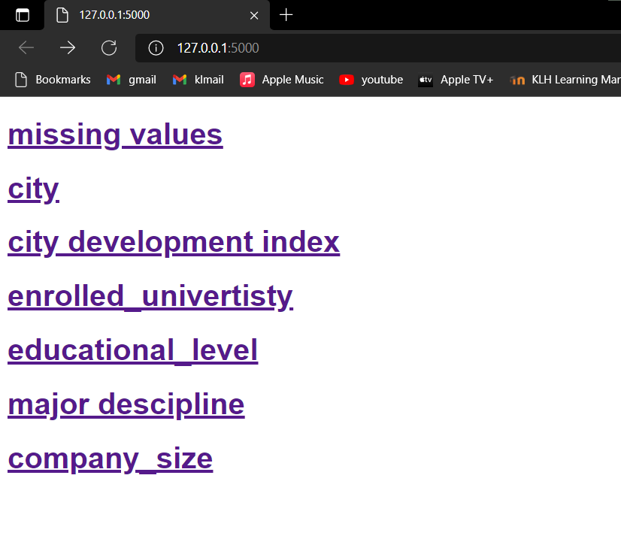
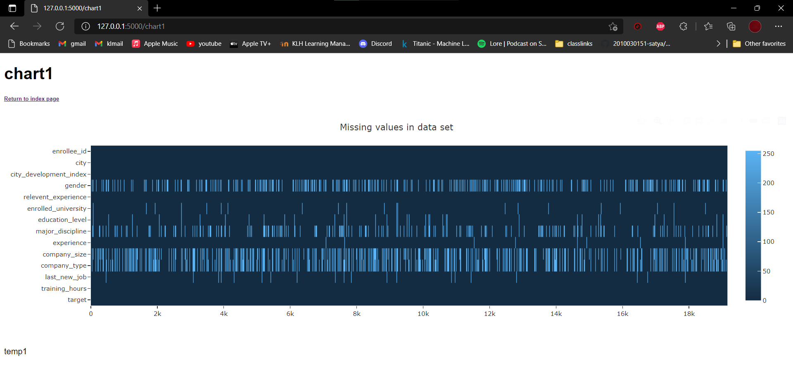
APLHA TESTING

Slide 7
Suggestions

Slide 8
Thank you

